Slide 1
2009 – 2010 american marketing association collegiate case competition
jesse beyroutey
tyler ernst
catherine pao
kevin tucker

Slide 2
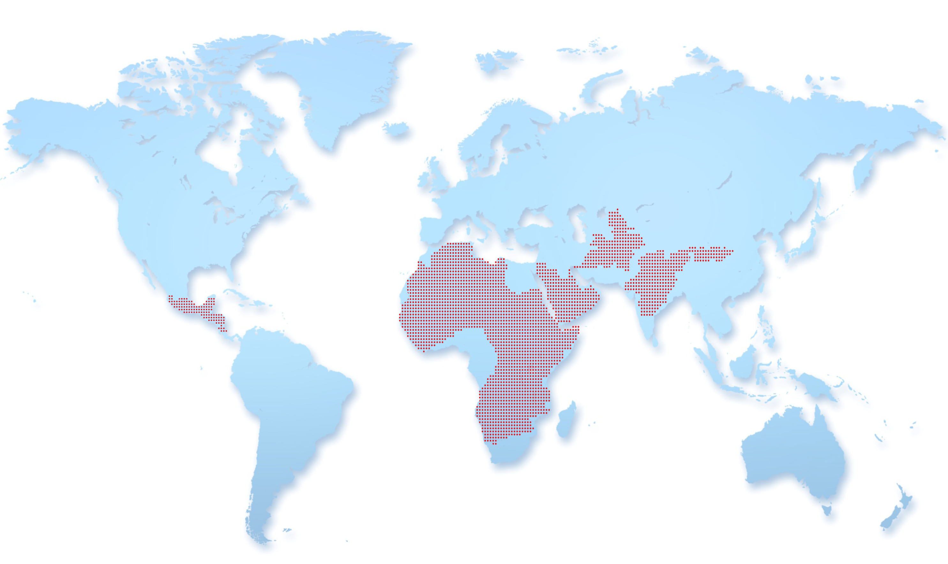
THE WATER CRISIS

Slide 3
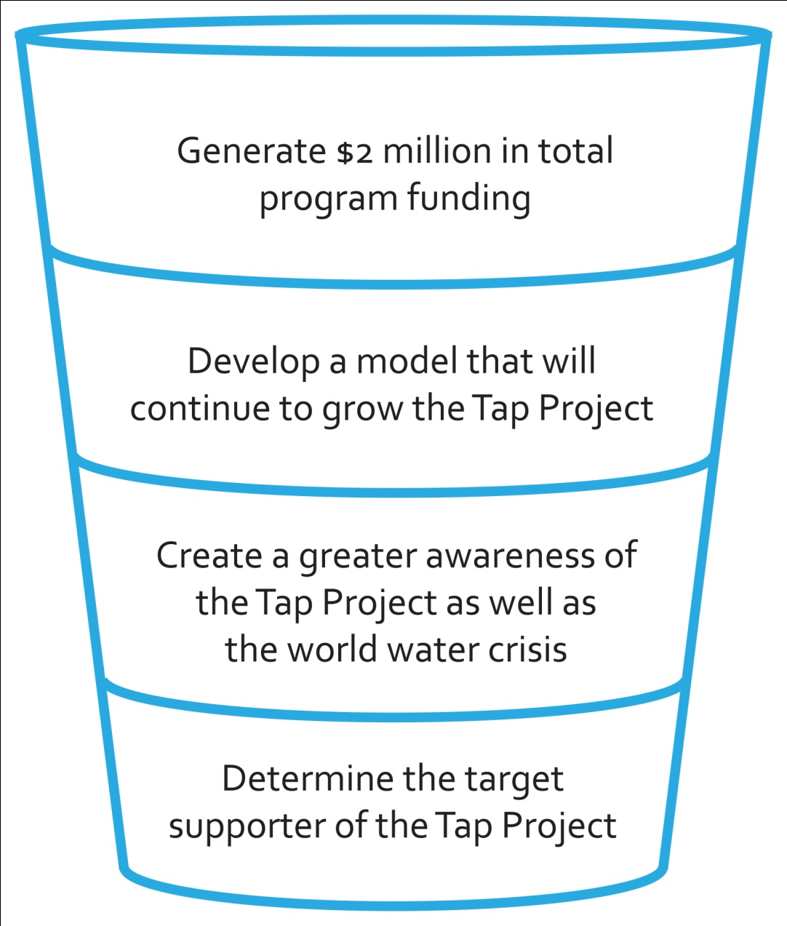
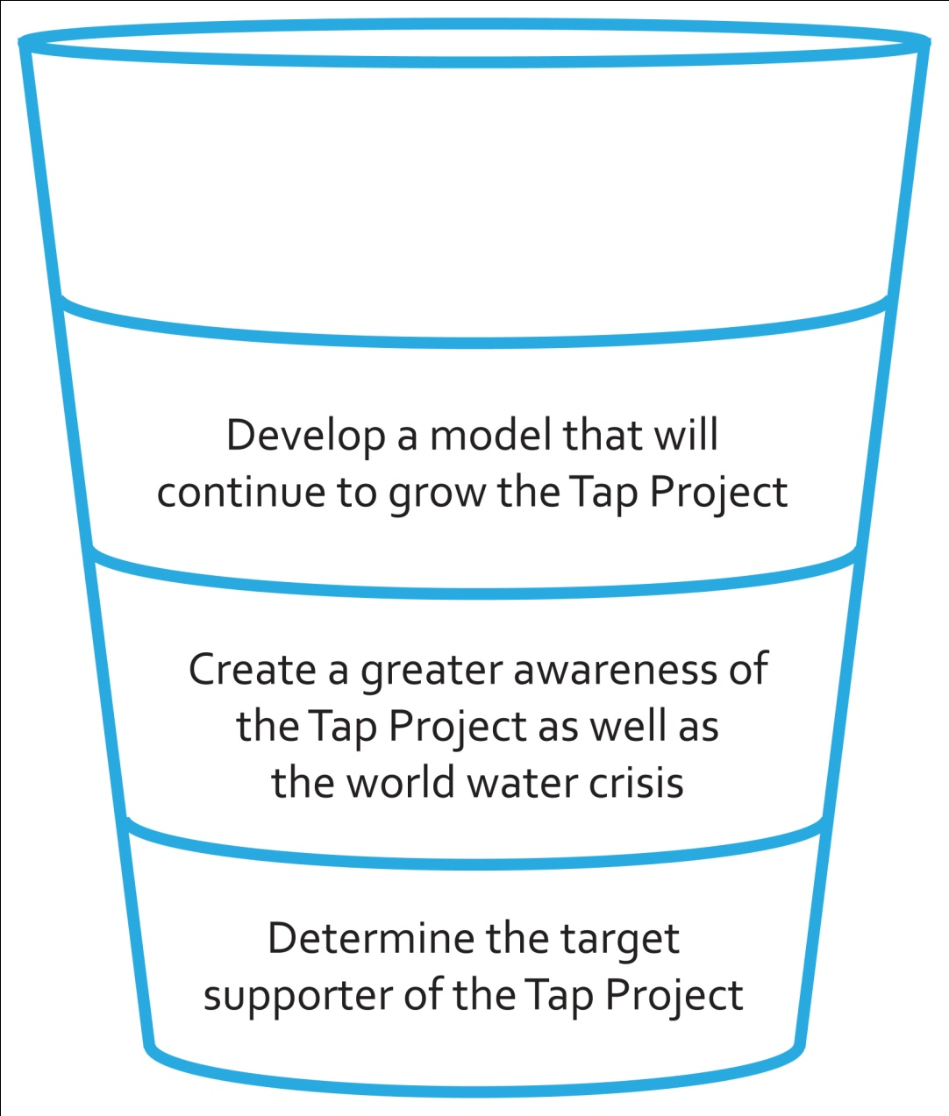
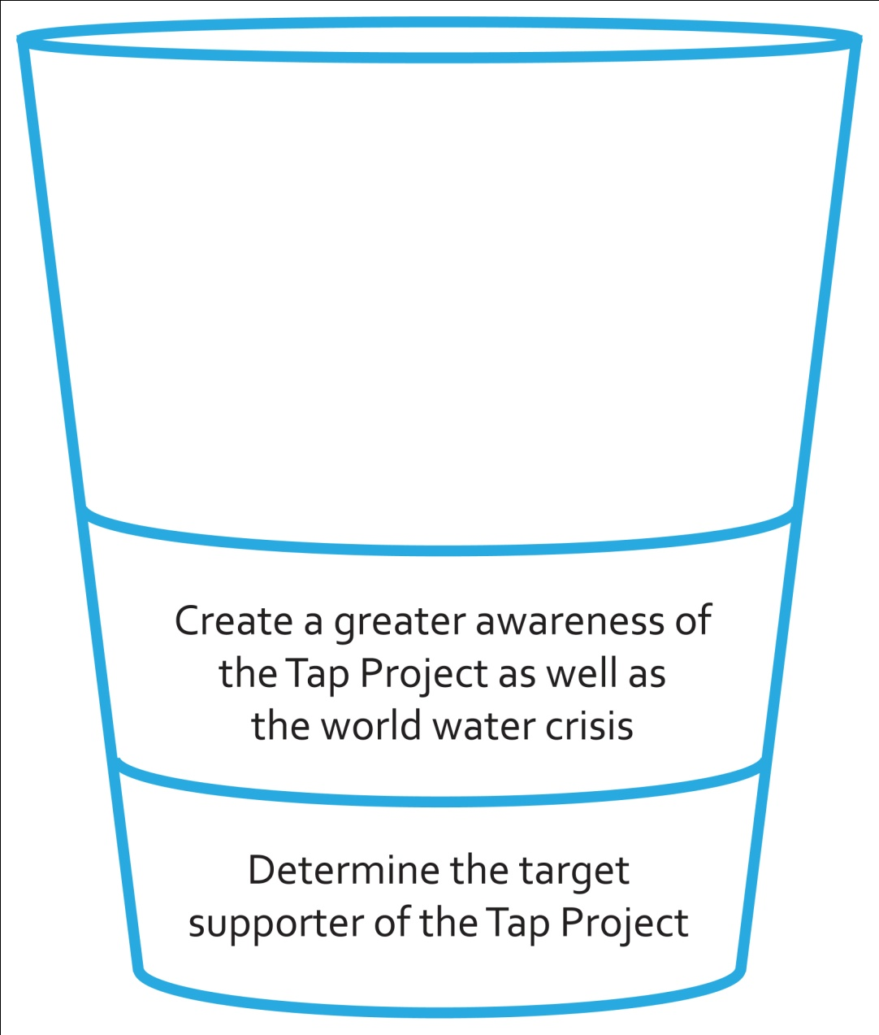
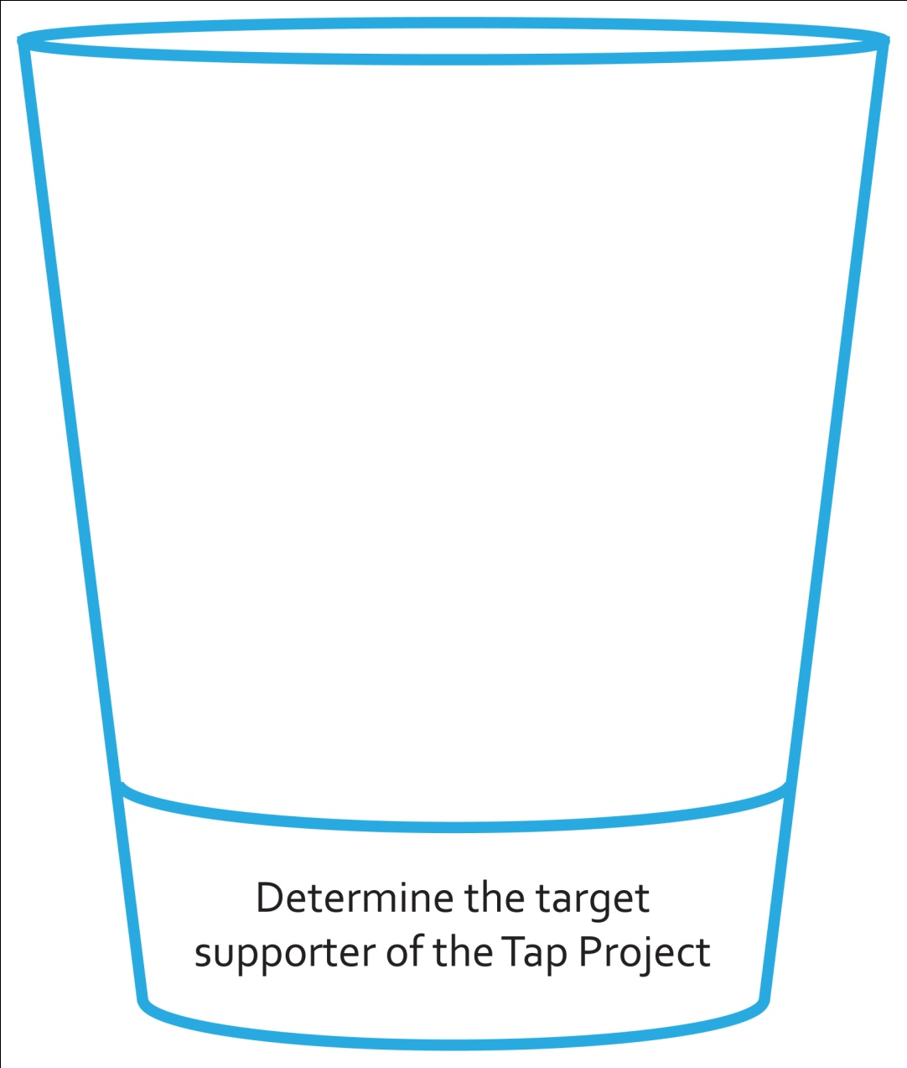
CASE OBJECTIVES

Slide 4
ROADMAP: LOOKING AHEAD
SITUATIONAL ANALYSIS
context & research
SEGMENTATION & STRATEGY
target donors & strategic vision
IMC
tactics & support plan

Slide 5
ROADMAP: LOOKING AHEAD
SITUATIONAL ANALYSIS
context & research
SEGMENTATION & STRATEGY
target donors & strategic vision
IMC
tactics & support plan

Slide 6
ROADMAP: LOOKING AHEAD
SITUATIONAL ANALYSIS
context & research
SEGMENTATION & STRATEGY
target donors & strategic vision
IMC
tactics & support plan

Slide 7
SITUATIONAL ANALYSIS

Slide 8
SWOT ANALYSIS
 | internal | external
positive | strengths | opportunities
negative | weaknesses | threats

Slide 9
SWOT ANALYSIS
 | internal | external
positive | strengths dedicated local volunteers existing partnerships novel business model | opportunities
negative | weaknesses | threats

Slide 10
SWOT ANALYSIS
 | internal | external
positive | strengths dedicated local volunteers existing partnerships novel business model | opportunities
negative | weaknesses event-driven fundraising regionalized control structure weak relationship between donors and tap project | threats

Slide 11
SWOT ANALYSIS
 | internal | external
positive | strengths dedicated local volunteers existing partnerships novel business model | opportunities mobile giving and social media dedicated local volunteers full leverage of unicef brand
negative | weaknesses event-driven fundraising regionalized control structure weak relationship between donors and tap project | threats

Slide 12
SWOT ANALYSIS
 | internal | external
positive | strengths dedicated local volunteers existing partnerships novel business model | opportunities mobile giving and social media dedicated local volunteers full leverage of unicef brand
negative | weaknesses event-driven fundraising regionalized control structure weak relationship between donors and tap project | threats depressed economic climate fragmentation of water charity space increasing number of competitors

Slide 13
COMPETITIVE ANALYSIS
source: google analytics

Slide 14
COMPETITIVE COMPARISONS
charity: water
brand awareness | ✓ | ✓
widely trusted brand | ✓ | ✓
emotional connection |  | ✓
fosters donor identity |  | ✓

Slide 15
RESEARCH METHODOLOGY
qualitative | quantitative

Slide 16
RESEARCH METHODOLOGY
qualitative | quantitative
interviews
18 tap project city coordinators, restaurant managers, & volunteers
insights & perspectives into the tap project

Slide 17
RESEARCH METHODOLOGY
qualitative | quantitative
interviews | surveys
18 tap project city coordinators, restaurant managers, & volunteers | 528 respondents
insights & perspectives into the tap project | segmentation & environment

Slide 18
RESEARCH METHODOLOGY
qualitative | quantitative
interviews | surveys
18 tap project city coordinators, restaurant managers, & volunteers | 528 respondents | 195 respondents
insights & perspectives into the tap project | segmentation & environment | targeting & tactics

Slide 19
RESEARCH TAKEAWAYS
 | research | key takeaway
methods
means

Slide 20
RESEARCH TAKEAWAYS
 | research | key takeaway
methods | donors have exceptional level of trust in unicef brand | associate the tap project more closely with positive associations of unicef
 | emotional appeals twice as effective as rational in eliciting response | integrate positive emotions into rational marketing campaigns
means

Slide 21
RESEARCH TAKEAWAYS
 | research | key takeaway
methods | donors have exceptional level of trust in unicef brand | associate the tap project more closely with positive associations of unicef
 | emotional appeals twice as effective as rational in eliciting response | integrate positive emotions into rational marketing campaigns
means | majority of consumers donate money not time | convenient donation outlets that engage donors
 | 2/3 of respondents prefer smaller donations twice a year | smaller donations with higher frequency

Slide 22
SEGMENTATION

Slide 23
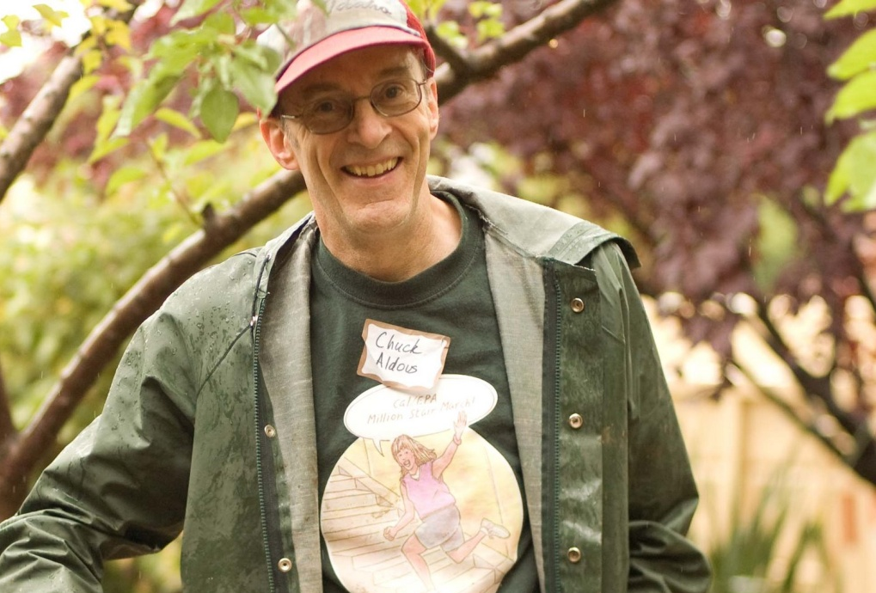
SEGMENTATION
impact seekers
motivation:
need:
reason:
behavior:
fulfill mission and goals of the cause
strong impact
personally know those affected
dedication

Slide 24
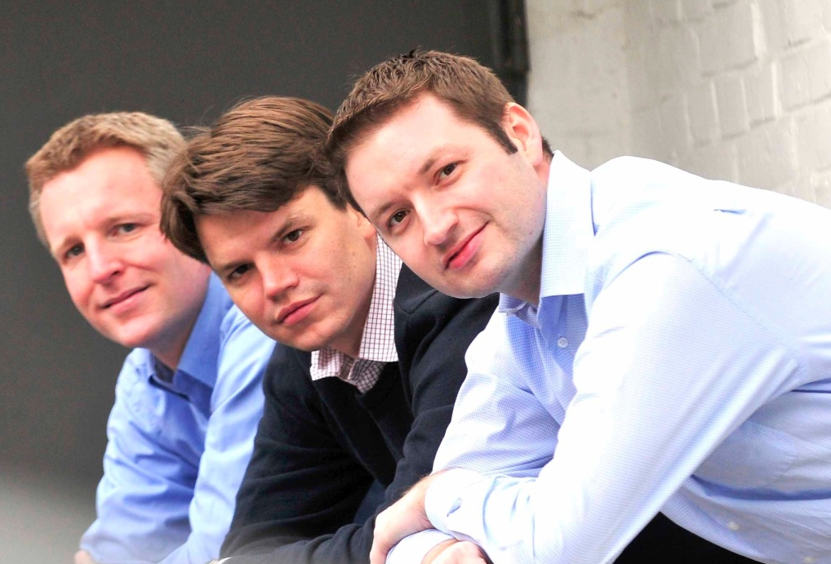
SEGMENTATION
skeptical localists
motivation:
need:
reason:
behavior:
local community impact
visible results
geographically close charities
noncommittal

Slide 25
SEGMENTATION
persistent connectors
motivation:
need:
reason:
behavior:
feeling of personal responsibility for results
control
influence a cause
demanding

Slide 26
SEGMENTATION
youthful dreamers
motivation:
need:
reason:
behavior:
be part of a movement greater than self
attachment to others
popular current cause
emotional & impulsive

Slide 27
SEGMENT COMPARISON
 | impact seekers | skeptical localists | persistent connectors | youthful dreamers
size | 24.3% | 26.1% | 19.7% | 29.8%
spread ideas virally |  |  |  | ✓
inexpensive to convert | ✓ |  |  | ✓
achieve funding objective |  |  | ✓ | ✓
longevity | ✓ |  |  | ✓

Slide 28
SEGMENT COMPARISON
 | impact seekers | skeptical localists | persistent connectors | youthful dreamers
size | 24.3% | 26.1% | 19.7% | 29.8%
spread ideas virally |  |  |  | ✓
inexpensive to convert | ✓ |  |  | ✓
achieve funding objective |  |  | ✓ | ✓
longevity | ✓ |  |  | ✓

Slide 29
SEGMENT COMPARISON
 | impact seekers | skeptical localists | persistent connectors | youthful dreamers
size | 24.3% | 26.1% | 19.7% | 29.8%
spread ideas virally |  |  |  | ✓
inexpensive to convert | ✓ |  |  | ✓
achieve funding objective |  |  | ✓ | ✓
longevity | ✓ |  |  | ✓

Slide 30
SEGMENT COMPARISON
 | impact seekers | skeptical localists | persistent connectors | youthful dreamers
size | 24.3% | 26.1% | 19.7% | 29.8%
spread ideas virally |  |  |  | ✓
inexpensive to convert | ✓ |  |  | ✓
achieve funding objective |  |  | ✓ | ✓
longevity | ✓ |  |  | ✓

Slide 31
SEGMENT COMPARISON
 | impact seekers | skeptical localists | persistent connectors | youthful dreamers
size | 24.3% | 26.1% | 19.7% | 29.8%
spread ideas virally |  |  |  | ✓
inexpensive to convert | ✓ |  |  | ✓
achieve funding objective |  |  | ✓ | ✓
longevity | ✓ |  |  | ✓

Slide 32
SEGMENT COMPARISON
 | impact seekers | skeptical localists | persistent connectors | youthful dreamers
size | 24.3% | 26.1% | 19.7% | 29.8%
spread ideas virally |  |  |  | ✓
inexpensive to convert | ✓ |  |  | ✓
achieve funding objective |  |  | ✓ | ✓
longevity | ✓ |  |  | ✓

Slide 33
SEGMENT COMPARISON
 | impact seekers | skeptical localists | persistent connectors | youthful dreamers
size | 24.3% | 26.1% | 19.7% | 29.8%
spread ideas virally |  |  |  | ✓
inexpensive to convert | ✓ |  |  | ✓
achieve funding objective |  |  | ✓ | ✓
longevity | ✓ |  |  | ✓

Slide 34
SEGMENT COMPARISON
 | impact seekers | skeptical localists | persistent connectors | youthful dreamers
size | 24.3% | 26.1% | 19.7% | 29.8%
spread ideas virally |  |  |  | ✓
inexpensive to convert | ✓ |  |  | ✓
achieve funding objective |  |  | ✓ | ✓
longevity | ✓ |  |  | ✓

Slide 35
SEGMENT COMPARISON
 | impact seekers | skeptical localists | persistent connectors | youthful dreamers
size | 24.3% | 26.1% | 19.7% | 29.8%
spread ideas virally |  |  |  | ✓
inexpensive to convert | ✓ |  |  | ✓
achieve funding objective |  |  | ✓ | ✓
longevity | ✓ |  |  | ✓

Slide 36
STRATEGY

Slide 37
STRATEGY & POSITIONING

Slide 38
STRATEGY & POSITIONING
Strategy
“Using its existing resources
in a new way, UNICEF can leverage
the affinity of Youthful Dreamers
to create a cycle that generates
continuous, sustainable revenue
for the UNICEF Tap Project.”

Slide 39
STRATEGY & POSITIONING
Strategy
“Using its existing resources
in a new way, UNICEF can leverage
the affinity of Youthful Dreamers
to create a cycle that generates
continuous, sustainable revenue
for the UNICEF Tap Project.”
Positioning
"To Youthful Dreamers,
the UNICEF Tap Project will become
an inspiring movement
by creating a unique identity
that directly connects peers
through their beliefs
in the giving power of water."

Slide 40
THE TAP CYCLE

Slide 41
THE TAP CYCLE
Incorporate
IMPACT-ORIENTED
MESSAGING
Drive
RECURRING
DONATIONS
Build
COMMUNITIES
Increase
ENGAGEMENT

Slide 42
THE TAP CYCLE
Incorporate
IMPACT-ORIENTED
MESSAGING
show impact through rational & emotional appeals
connect tap project perceptions with unicef

Slide 43
THE TAP CYCLE
Incorporate
IMPACT-ORIENTED
MESSAGING
Build
COMMUNITIES
cultivate strong affinity of youthful dreamers
positively reinforce beliefs of youthful dreamers

Slide 44
THE TAP CYCLE
Build
COMMUNITIES
Increase
ENGAGEMENT
connect donors & beneficiaries with authentic stories
develop deeper connections in donors & the tap project

Slide 45
THE TAP CYCLE
Drive
RECURRING
DONATIONS
Increase
ENGAGEMENT
supplement existing restaurant model
provide outlets to encourage more frequent donations

Slide 46
THE TAP CYCLE
Drive
RECURRING
DONATIONS
Incorporate
IMPACT-ORIENTED
MESSAGING
Drive
RECURRING
DONATIONS
Build
COMMUNITIES
Increase
ENGAGEMENT

Slide 47
INTEGRATED MARKETING COMMUNICATIONS

Slide 48
INCORPORATE IMPACT-ORIENTED MESSAGING
Incorporate
IMPACT-ORIENTED
MESSAGING
tactics
media & PR
‘water gives’ campaign print website banner

Slide 50
‘WATER GIVES’ PRINT CAMPAIGN

Slide 51
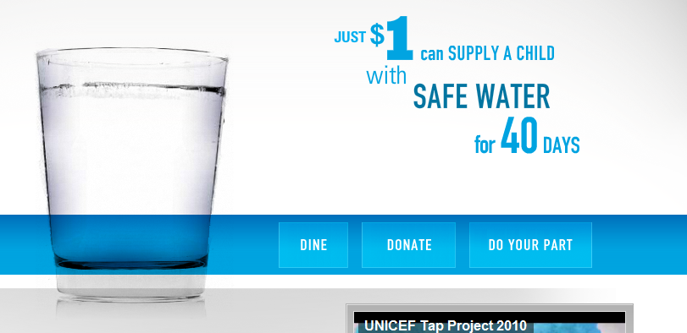
CURRENT TAP PROJECT WEBSITE

Slide 52
‘WATER GIVES’ WEBSITE UPDATE

Slide 53
BUILD COMMUNITIES
tactics
social media facebook twitter blogs
‘sister communities’
Build
COMMUNITIES

Slide 54
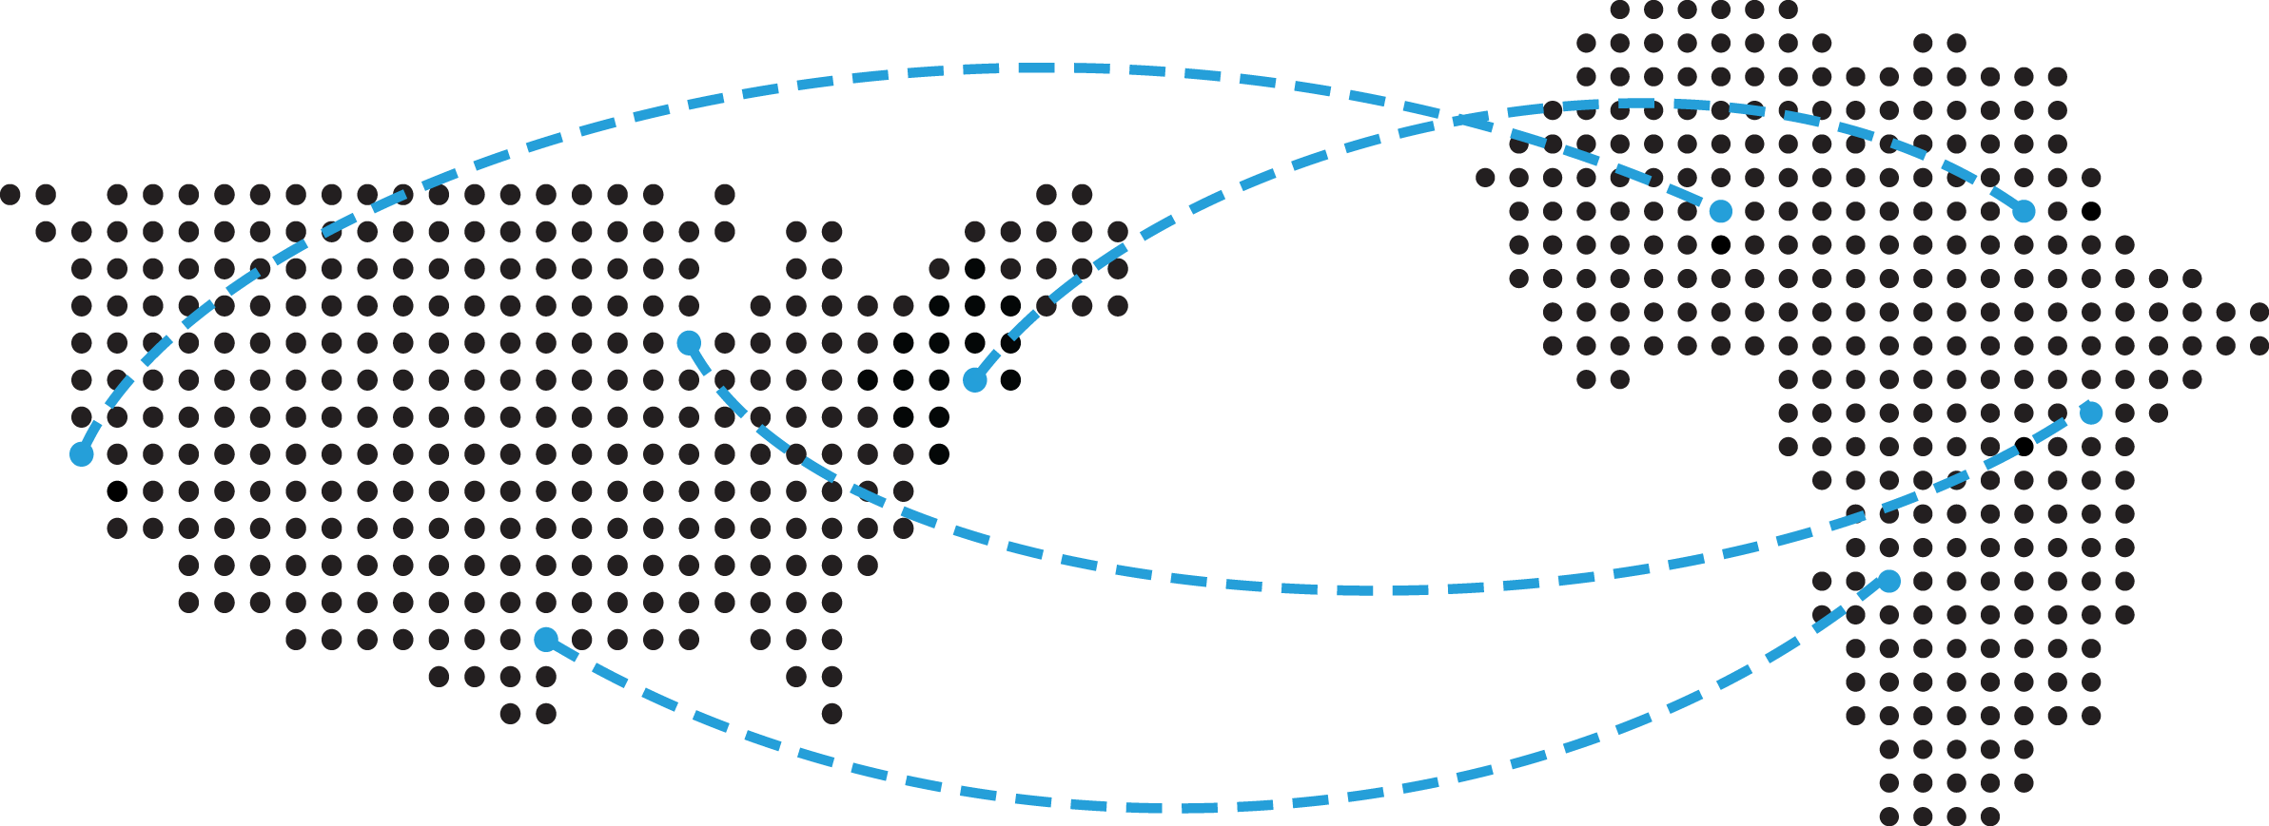
‘SISTER COMMUNITIES’

Slide 55
INCREASE ENGAGEMENT
tactics
‘pass the glass’ unique glass designs celebrity involvement glass tracking map
Increase
ENGAGEMENT

Slide 56
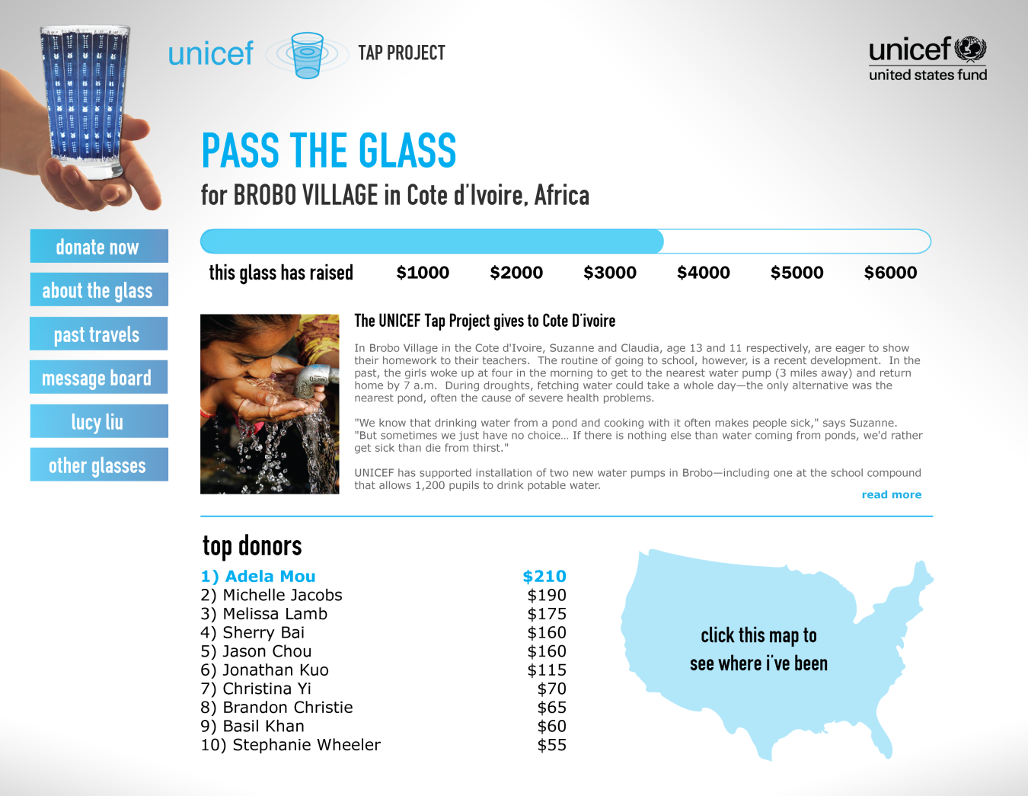
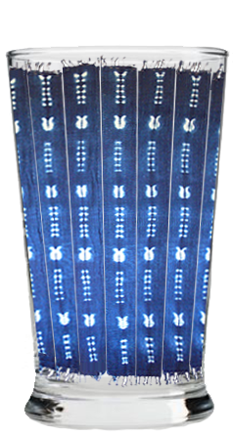
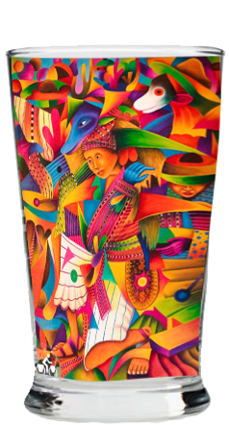
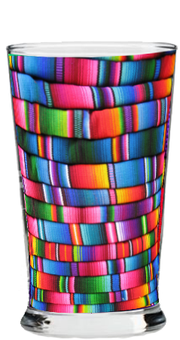
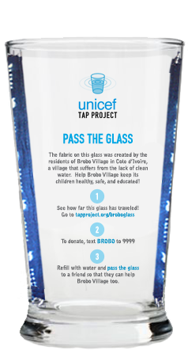
‘PASS THE GLASS’ CUP CONCEPT

Slide 57
DRIVE RECURRING DONATIONS
tactics
‘pass the glass’ partnerships
‘water gives education’
‘water gives beauty’
Drive
RECURRING
DONATIONS

Slide 58
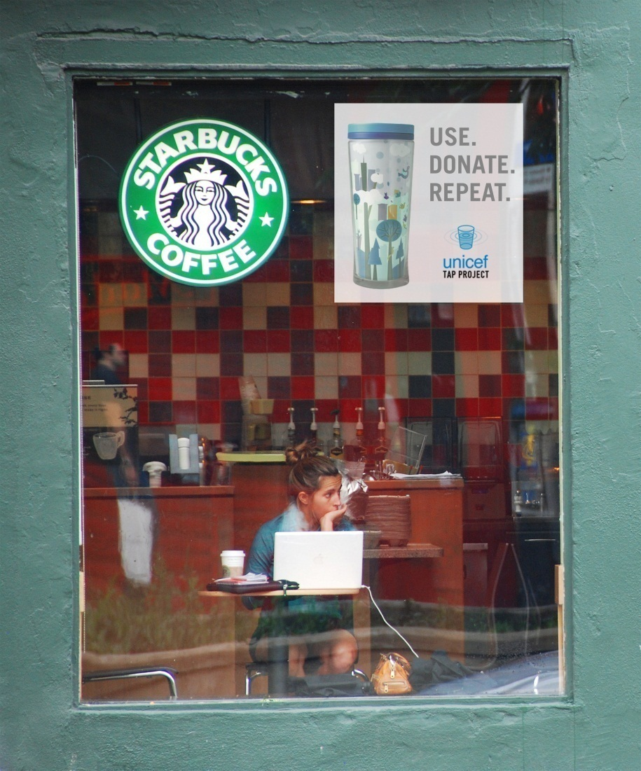
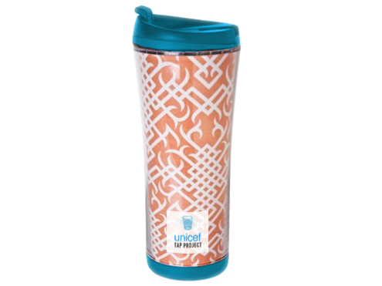
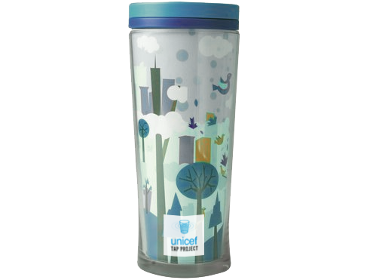
‘PASS THE GLASS’ PARTNERSHIPS

Slide 59
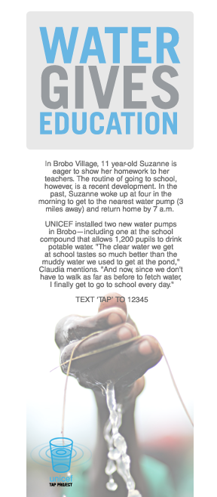
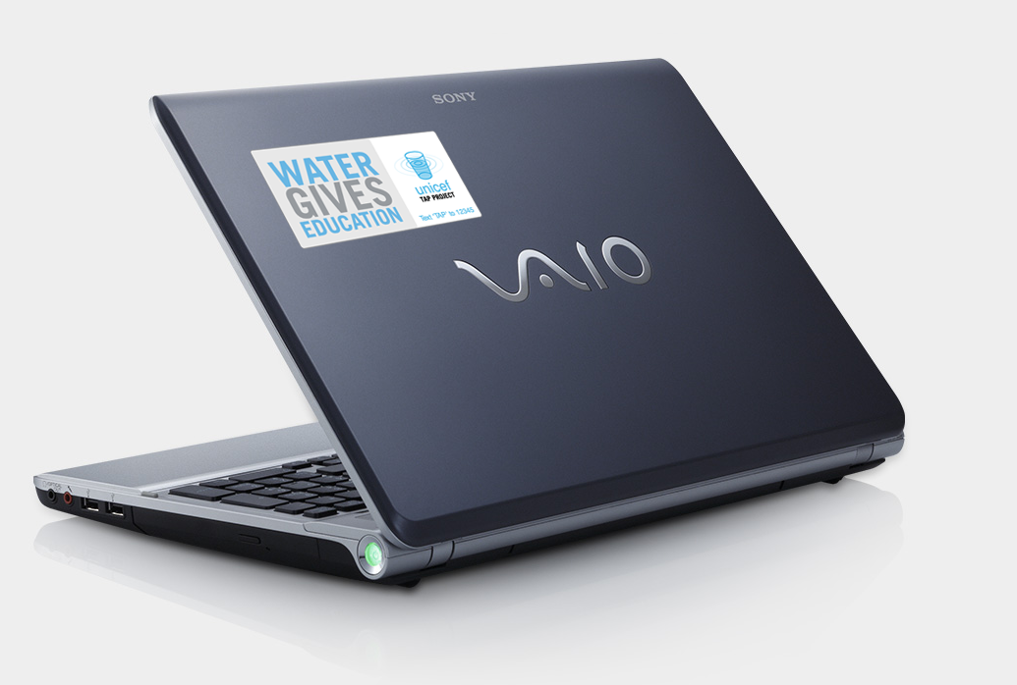
‘WATER GIVES EDUCATION’

Slide 60
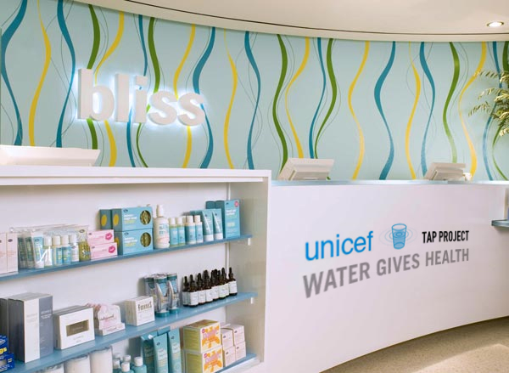
‘WATER GIVES HEALTH’

Slide 61
IMC TIMELINE
 | incorporate impact-oriented messaging |  |  | build communities |  |  | increase Engagement |  |  | drive recurring donations
imc tactic | mar | apr | may | jun | jul | aug | sep | oct | nov | dec | jan | feb
media & pr
‘txt4tap’
website content update
‘water gives’ print ads
‘water gives’ banner ads
volunteer training
social media
‘sister communities’
‘pass the glass’
‘water gives education’
‘water gives health’
donation driver | mar | apr | may | jun | jul | aug | sep | oct | nov | dec | jan | feb
‘water week’
‘txt4tap’
‘sister communities’
‘pass the glass’
‘water gives education’
‘water give health’

Slide 62
IMC BUDGET
initiative | cost
‘water gives’ campaign | $10,421.00
website update | $2134.00
‘water gives’ fundraising | $106,600.00
‘pass the glass’ | $112,739.00
social media | $2,040.00
public transportation | $7,300.00
other | $28,008.00
total | $269,242.00

Slide 63
TAKEAWAYS

Slide 64
FINANCIAL PROJECTIONS

Slide 65
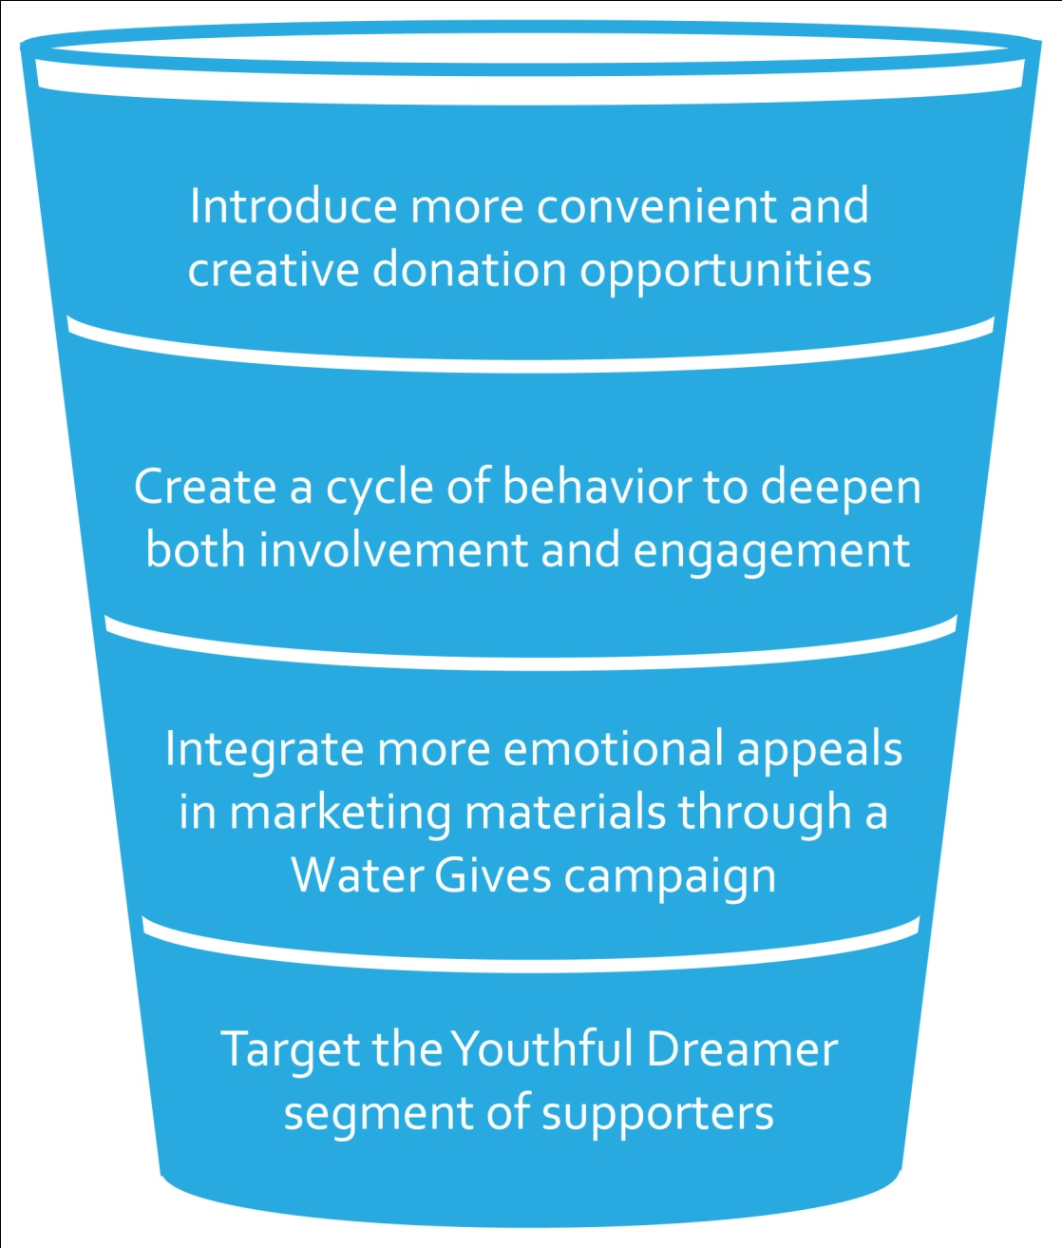
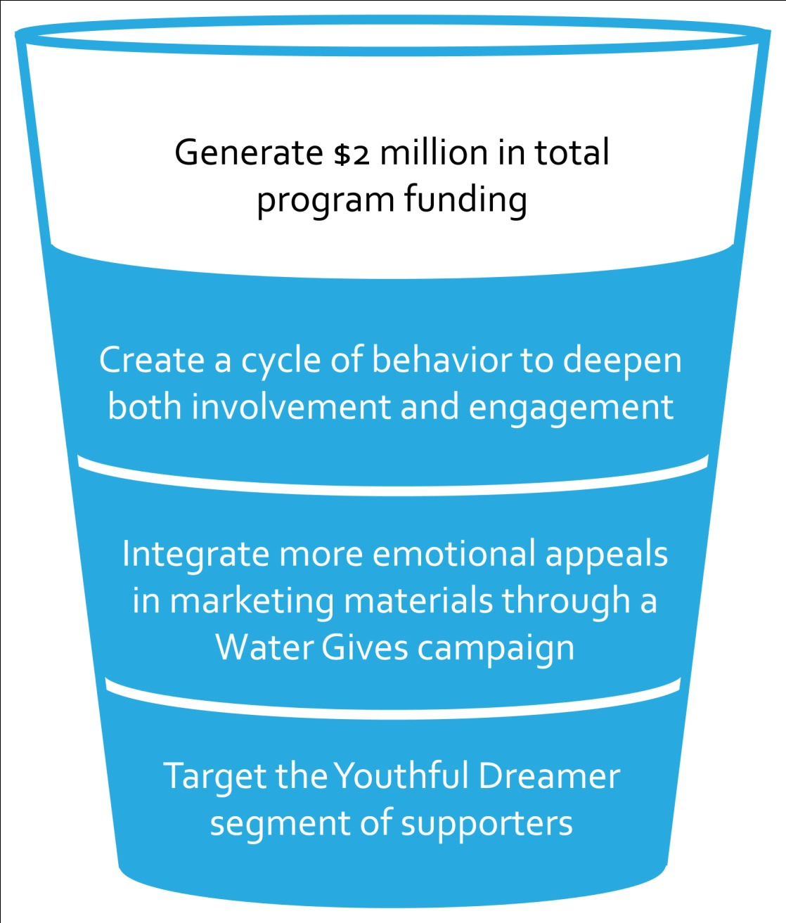
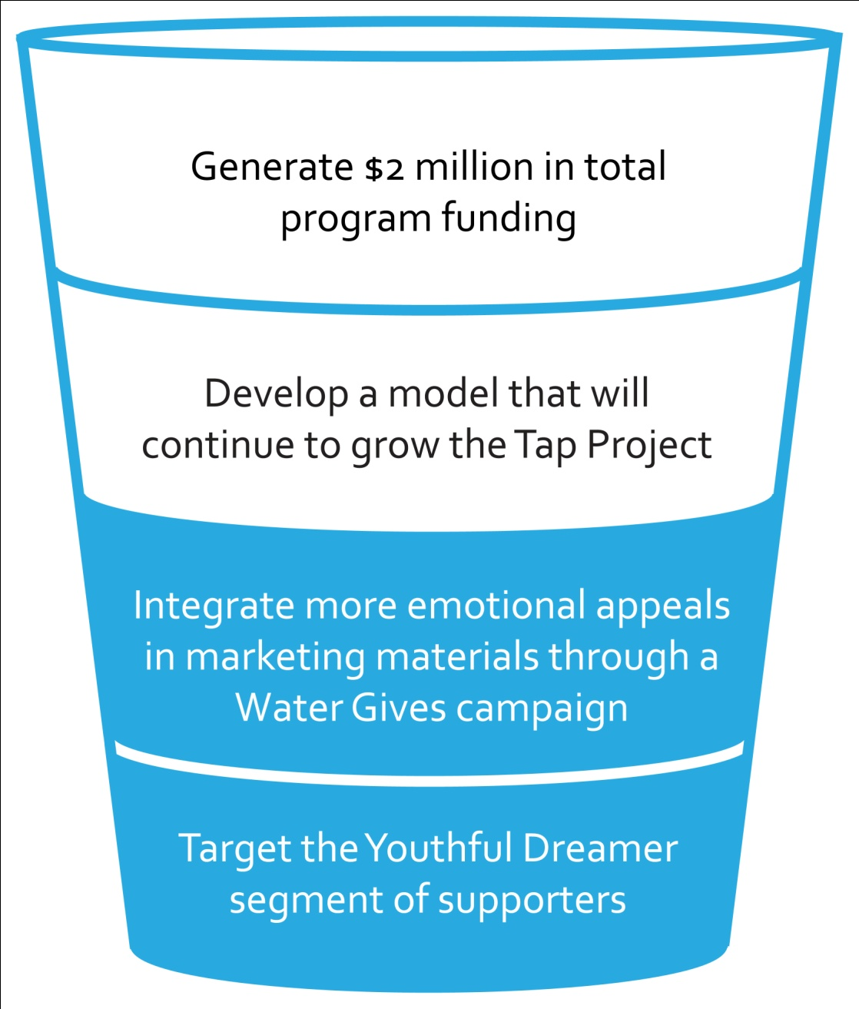
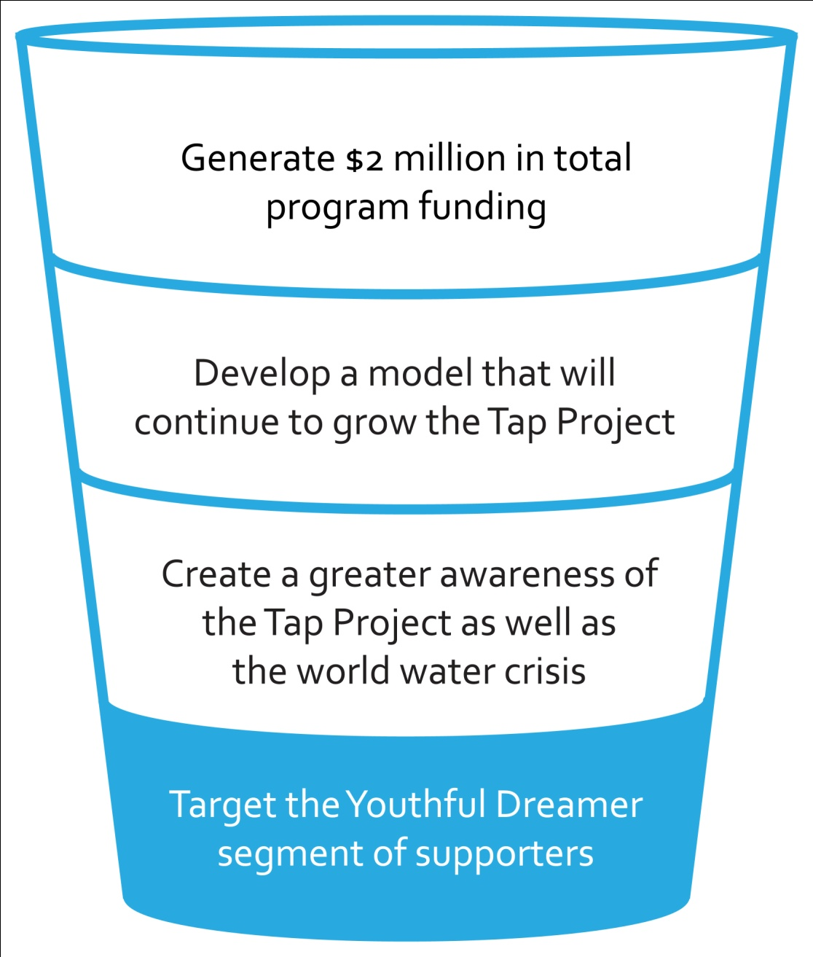
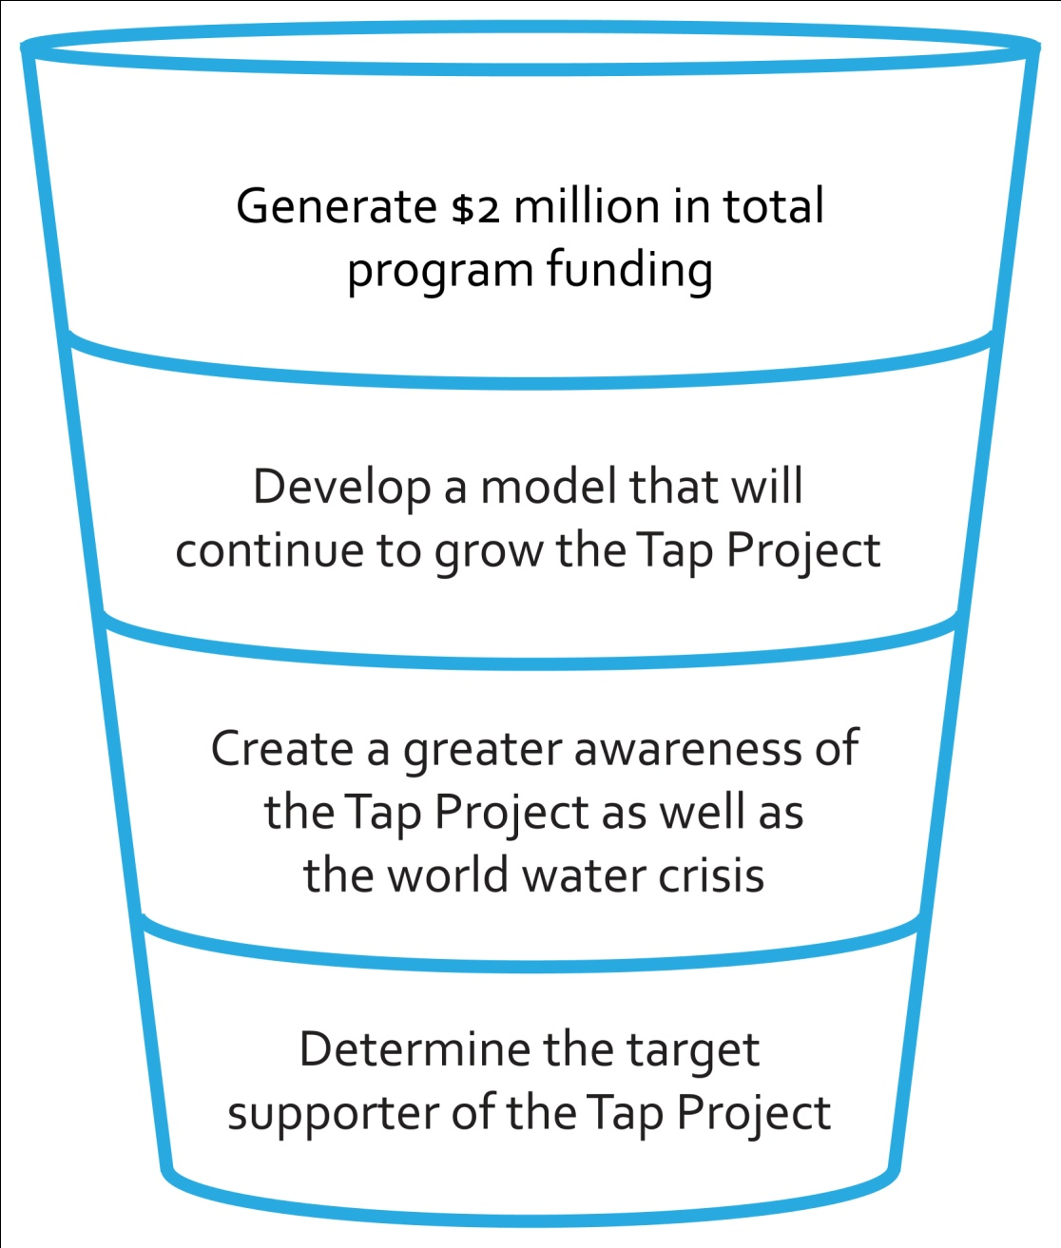
OUR SOLUTIONS

Slide 67
QUESTIONS?
swot [s] [w] [o] [t]
research [methodology] [takeaways]
[segmentation]
[strategy & positioning]
[the tap cycle]
imc tactics [1] [2] [3] [4]
imc [timeline] [budget] [projections]
[summary]

